Slide 1
Memory and History

Slide 2
Maya Lin, Vietnam Veterans Memorial, 1984. Black granite, two walls each 246' (75 m) long, rising to an apex of 10' 1" (3 m). Washington, D.C.

Slide 3
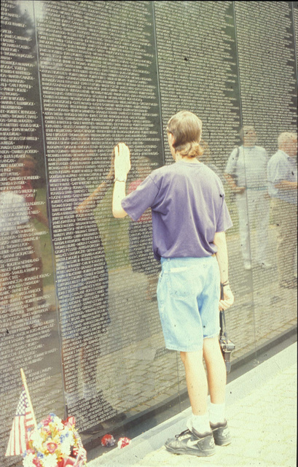

Slide 4
Maya Lin, Vietnam Veterans Memorial, 1984. Detail.

Slide 5
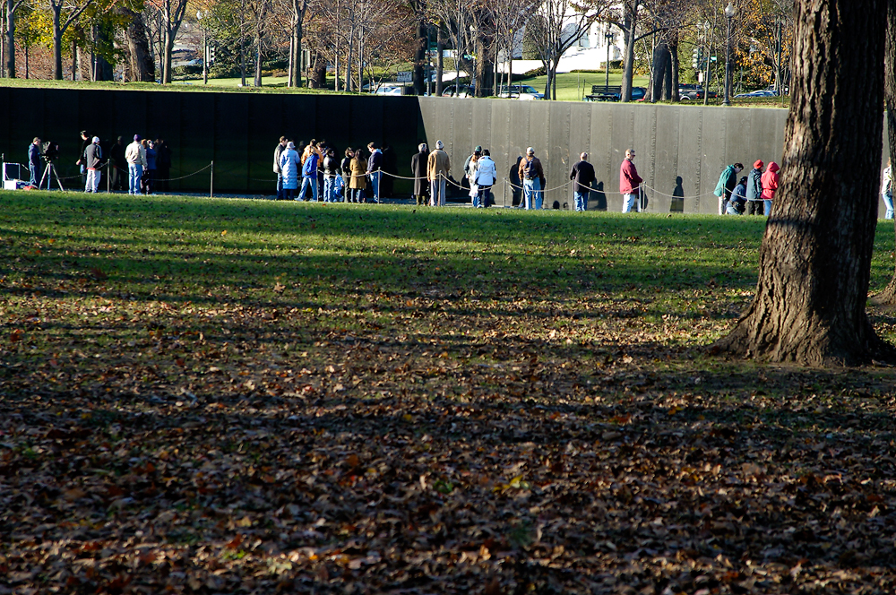
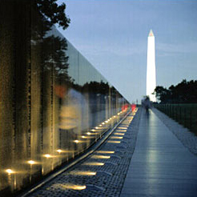
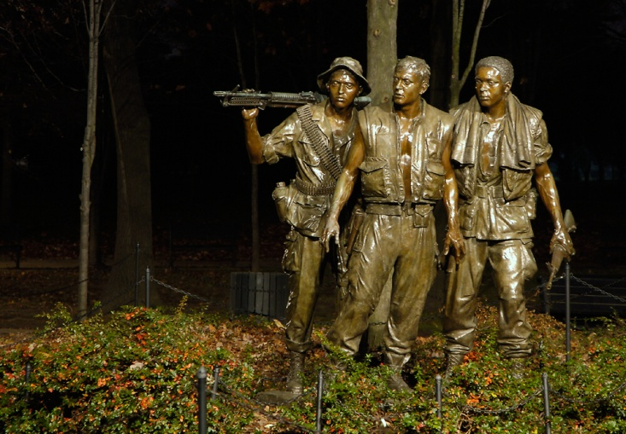
Maya Lin, Vietnam Veterans Memorial, polished black granite, 1982, Washington DC. (below left) Frederick Hart, Vietnam Veterans Memorial, 1984. Fills minimalist form with new democratic memorial content that subverts the traditional idealization of the single heroic leader. Compare Washington obelisk, above right.

Slide 6
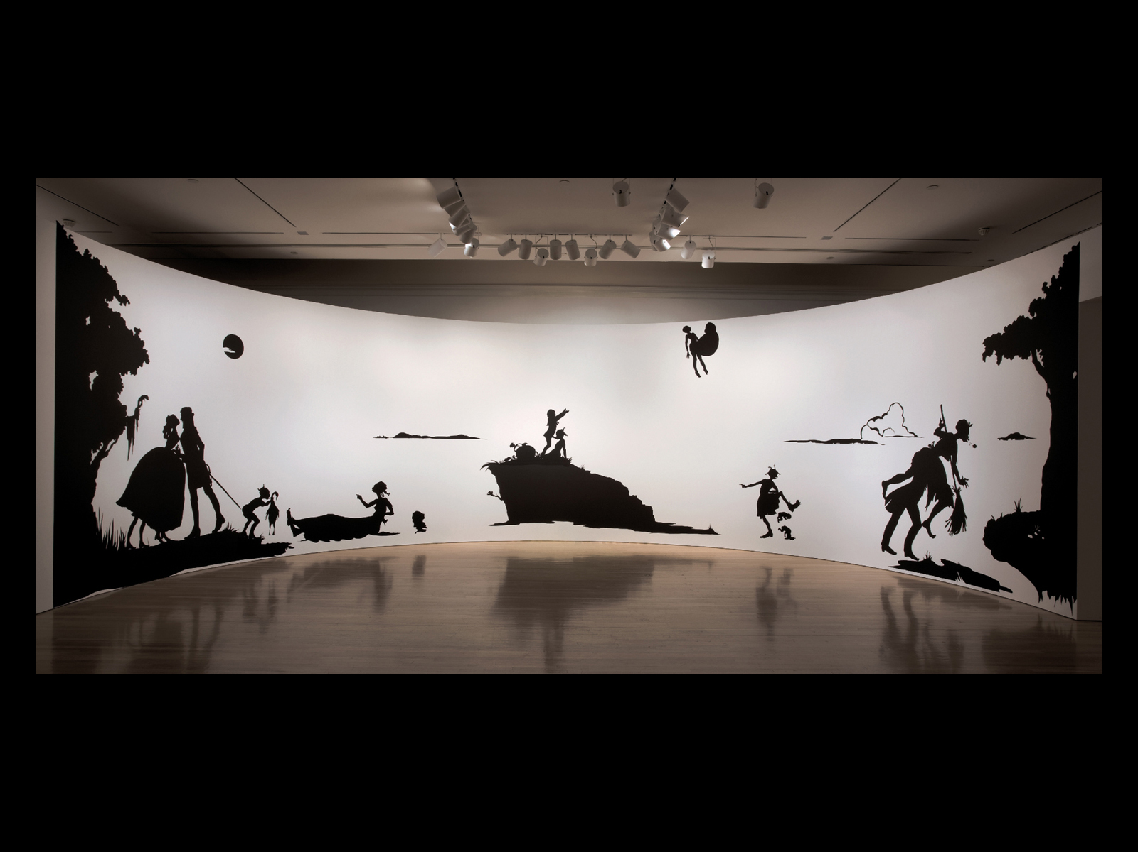
Kara Walker, Gone: An Historical Romance of the Civil War As It Occurred Between the Dusky Thighs of One Young Negress and Her Heart, 1994. Detail. Cut paper on wall, ca. 180” x 50' (396.2 cm x 15.24 m). Installed at the Museum of Modern Art, New York
Notes:
6.18 Kara Walker, Gone: An Historical Romance of the Civil War As It Occurred Between the Dusky Thighs of One Young Negress and Her Heart, 1994. Detail. Cut paper on wall, ca. 180” x 50' (396.2 cm x 15.24 m). Installed at the Museum of Modern Art, New York. © 2012 Kara Walker/Image courtesy of Sikkema Jenkins & Co., New York.

Slide 7
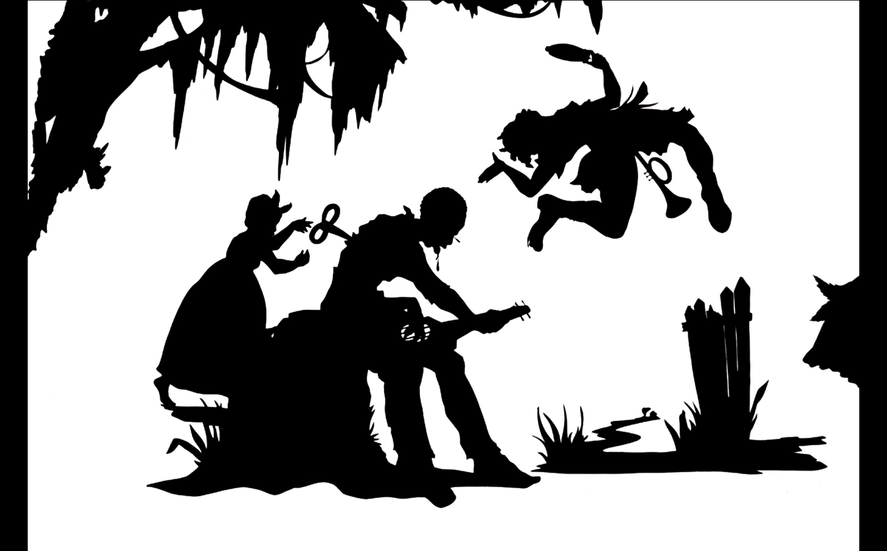
Kara Walker, PRESENTING NEGRO SCENES DRAWN UPON MY PASSAGE THROUGH THE SOUTH AND RECONFIGURED FOR THE BENEFIT OF ENLIGHTENED AUDIENCES WHEREVER SUCH MAY BE FOUND, BY MYSELF, MISSUS K.E.B. WALKER, COLORED, 1997. Detail. Cut paper on wall, cut paper on paper, ca. 144” x 155' (365.8 cm x 47.24 m). Installed at the Museum of Contemporary Art, Chicago.
Notes:
6.19 Kara Walker, PRESENTING NEGRO SCENES DRAWN UPON MY PASSAGE THROUGH THE SOUTH AND RECONFIGURED FOR THE BENEFIT OF ENLIGHTENED AUDIENCES WHEREVER SUCH MAY BE FOUND, BY MYSELF, MISSUS K.E.B. WALKER, COLORED, 1997. Detail. Cut paper on wall, cut paper on paper, ca. 144” x 155' (365.8 cm x 47.24 m). Installed at the Museum of Contemporary Art, Chicago. © 2012 Kara Walker/Image courtesy of Sikkema Jenkins & Co., New York.

Slide 8
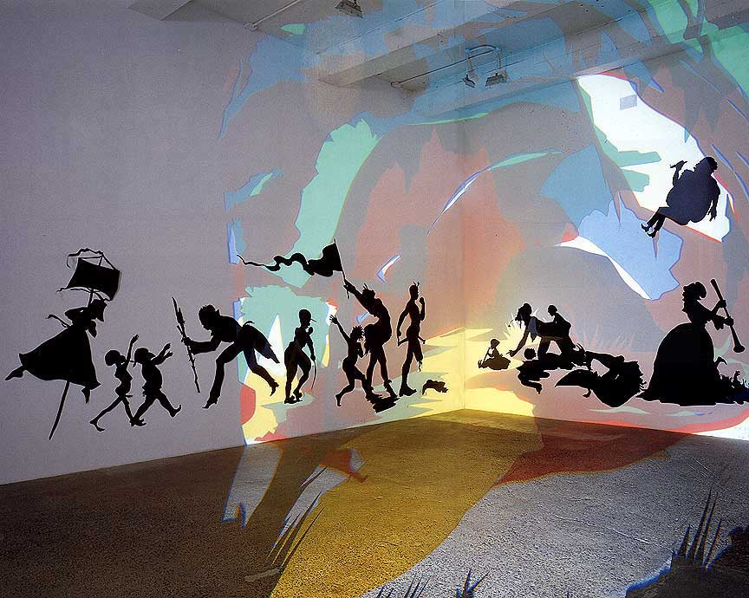
Kara Walker, Darkytown Rebellion, 2001, Installation view at Brent Sikkema, New York, Projection, cut paper and adhesive on wall, 14 x 37 1/2 feet
I had to reinvent or make up my own racist situation…In order to have a real connection with my history. I had to be somebody’s slave.”
Kara Walker

Slide 9
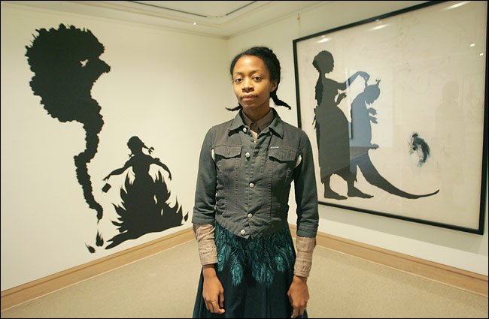
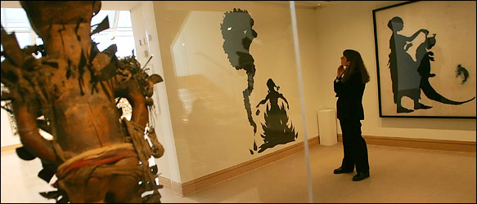
Kara Walker at the Met: After the Deluge, NYC Metropolitan Museum installation, 2006. Artist as curator combined her own work with pieces of African American art from the museum’s collection.

Slide 10
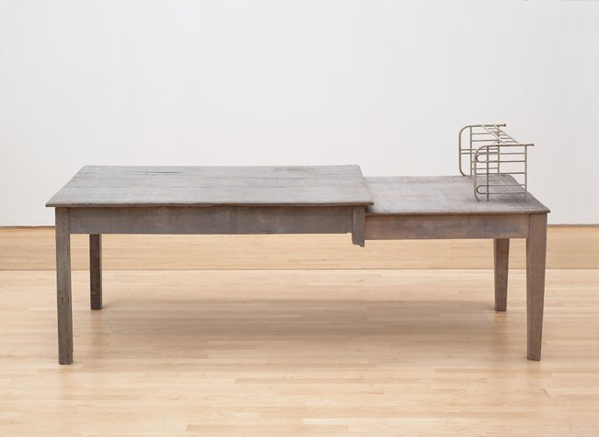
Doris Salcedo (Bogotá, Colombia, 1958), Unland: irreversible witness, 1995-1998, wood, cloth, metal, and hair
https://www.sfmoma.org/watch/doris-salcedo-memory-as-the-essence-of-work/

Slide 11
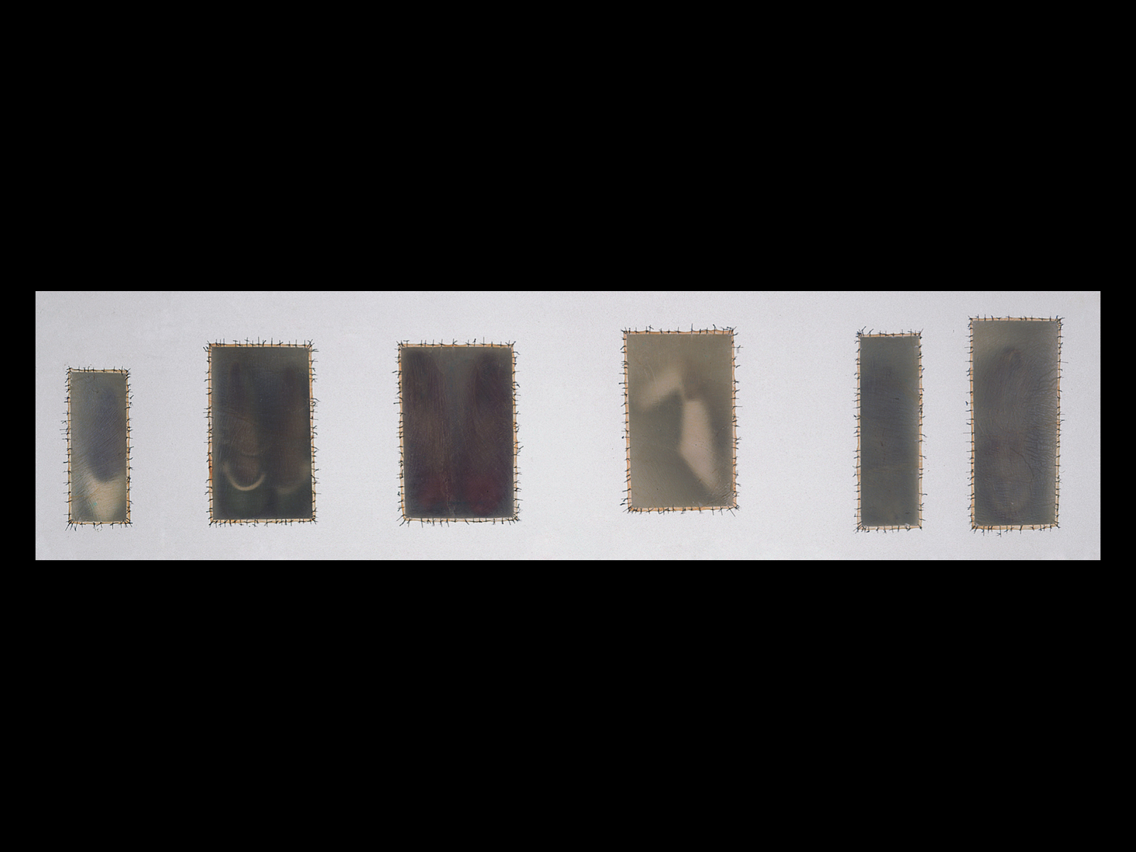
Doris Salcedo, Atrabiliarios, 1992–93. Detail. Wall installation with sheetrock, wood, shoes, animal fiber, and surgical thread in ten niches with 11 animal-fiber boxes sewn with surgical thread.

Slide 12
“The way that an artwork brings materials together is incredibly powerful. Sculpture is its materiality. I work with materials that are already charged with significance, with meaning they have acquired in the practice of everyday life…then, I work to the point where it becomes something else, where metamorphosis is reached.”
Doris Salcedo

Slide 13
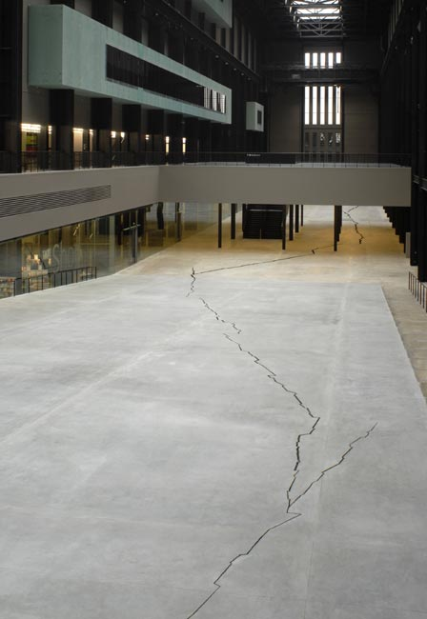
Doris Salcedo, Shibboleth, 2008, Turbine Hall, Tate

Slide 14
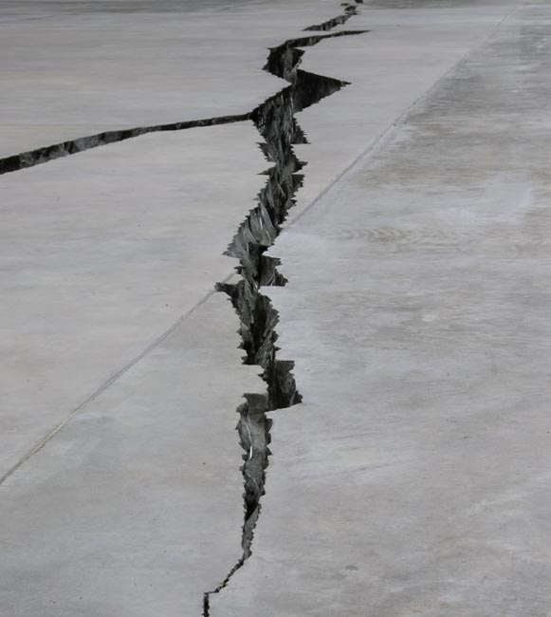

Slide 15
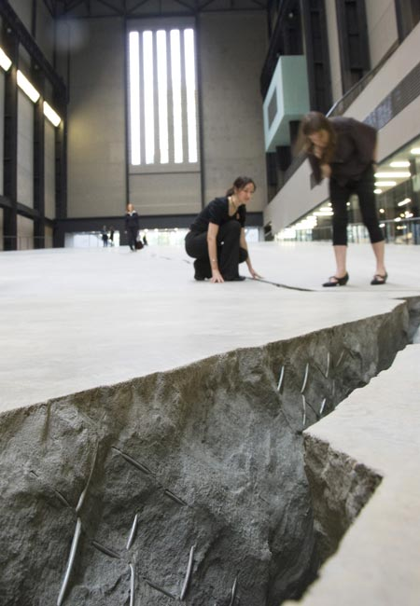
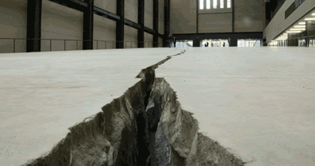
http://channel.tate.org.uk/media/28291797001
Video of Salcedo discussing her intentions
regarding Shibboleth

Slide 16
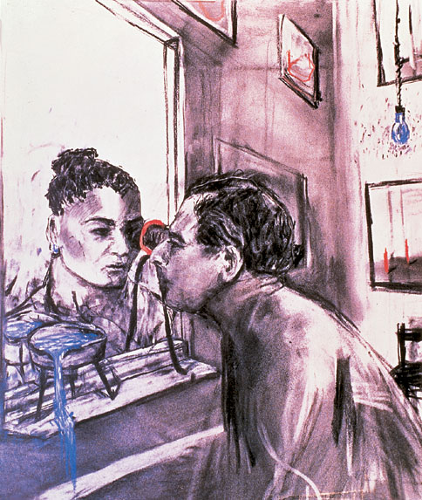
William Kentridge (South Africa,1955), Felix in Exile, 1994, video with sound, 00:08:43 Edition of 10, dimensions vary with installation
"I am interested in a political art, that is to say an art of ambiguity, contradiction, uncompleted gestures and uncertain ending - an art (and a politics) in which optimism is kept in check, and nihilism at bay."
William Kentridge
Hand-drawn animated films that focus on apartheid- and post-apartheid South Africa through two fictional white characters, the poetic, introspective Felix Teitlebaum and the aggressive industrialist Soho Eckstein, the artist’s alter egos. (Dates for apartheid in South Africa: 1948 – 1994)

Slide 17
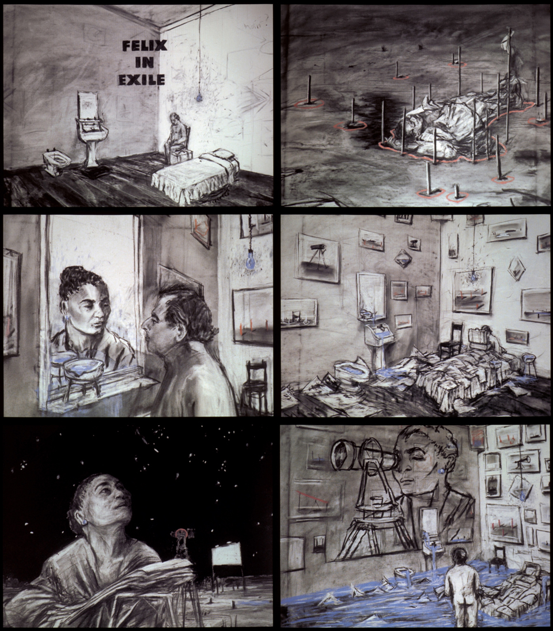
William Kentridge, Felix in Exile, 1994. Video stills. Whole film 8 minutes, 43 seconds.

Slide 18
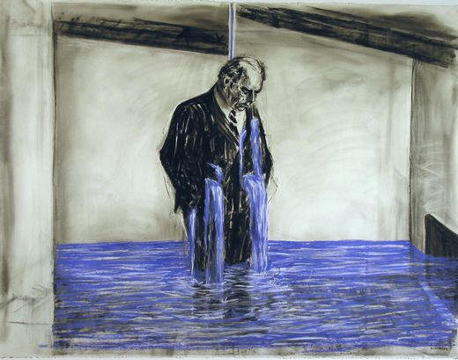
William Kentridge, Drawings (video stills) for Stereoscope, 1998-99, charcoal, pastel, and colored pencil on paper, 47 1/4 x 63“ Whole film 8 minutes, 22 seconds.

Slide 19
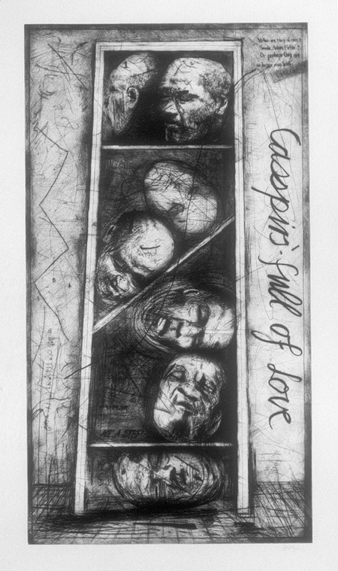
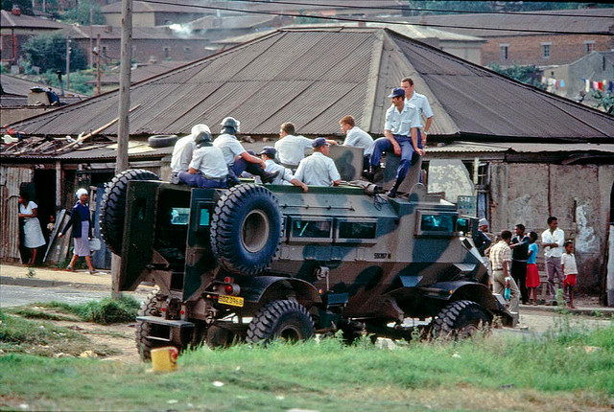
William Kentridge (South African, born 1955), Casspirs Full of Love, 1989–2000, drypoint; 65 1/2 x 38 3/8 in.
The Casspir, a landmine-protected personal vehicle, was ubiquitous during the days of apartheid in South Africa. It was commonly used in the townships for crowd and riot control.

Slide 20
History of the Main Complaint (1996). William Kentridge discusses how artists draw upon tragedy as subject matter for their work and how drawing itself can be a compassionate act.

Slide 21
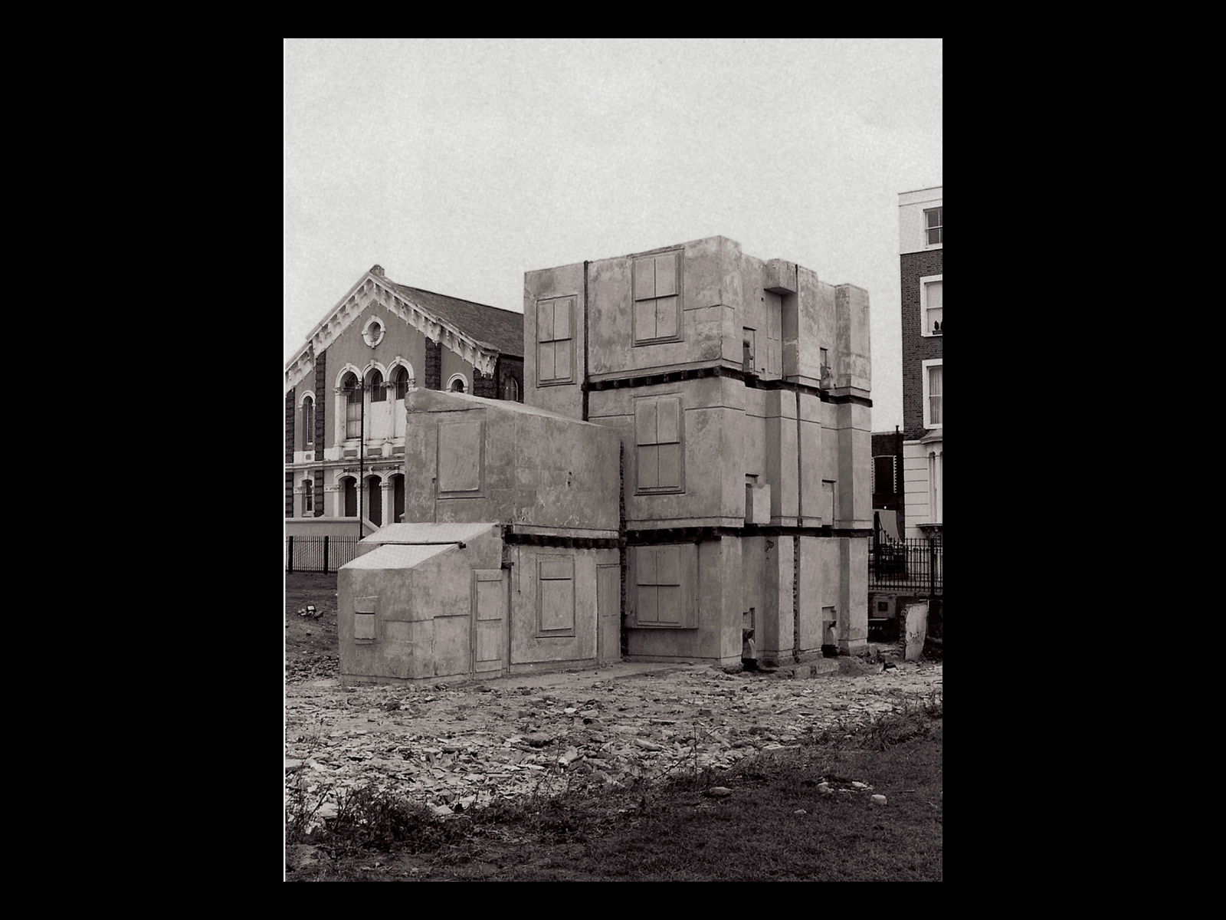
Rachel Whiteread, House, 1993. Grove Road, East London. Concrete, full size cast. Commissioned and produced by Artangel

Slide 22
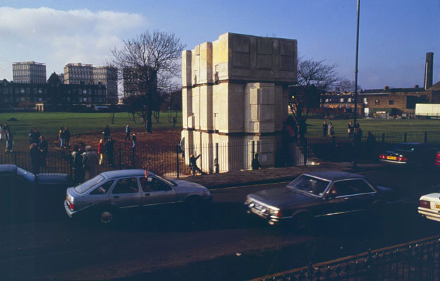
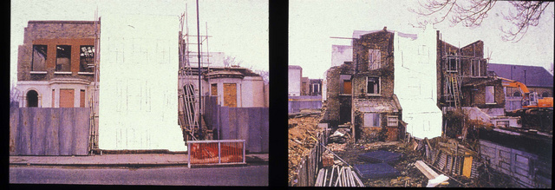
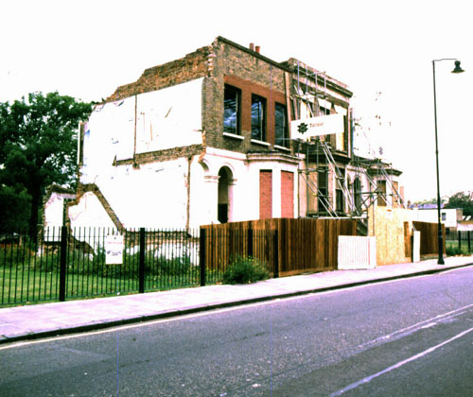
Rachel Whiteread (British b. 1963) House [East London], 1993-4

Slide 23
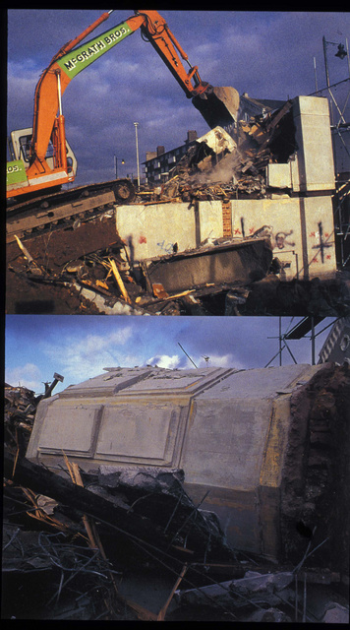
Demolition of House
on January 11, 1993

Slide 24
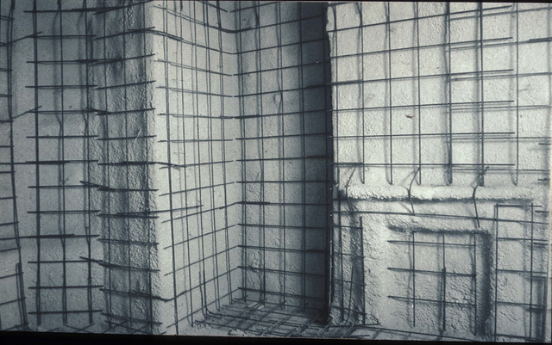
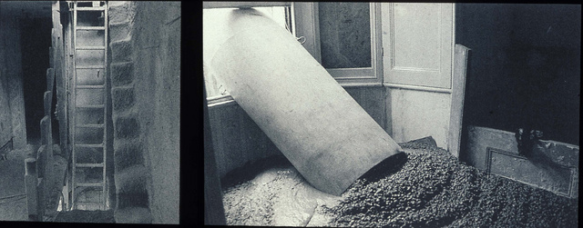
Rachel Whiteread, House, 1993, (left) before and after casting (below) casting process

Slide 25
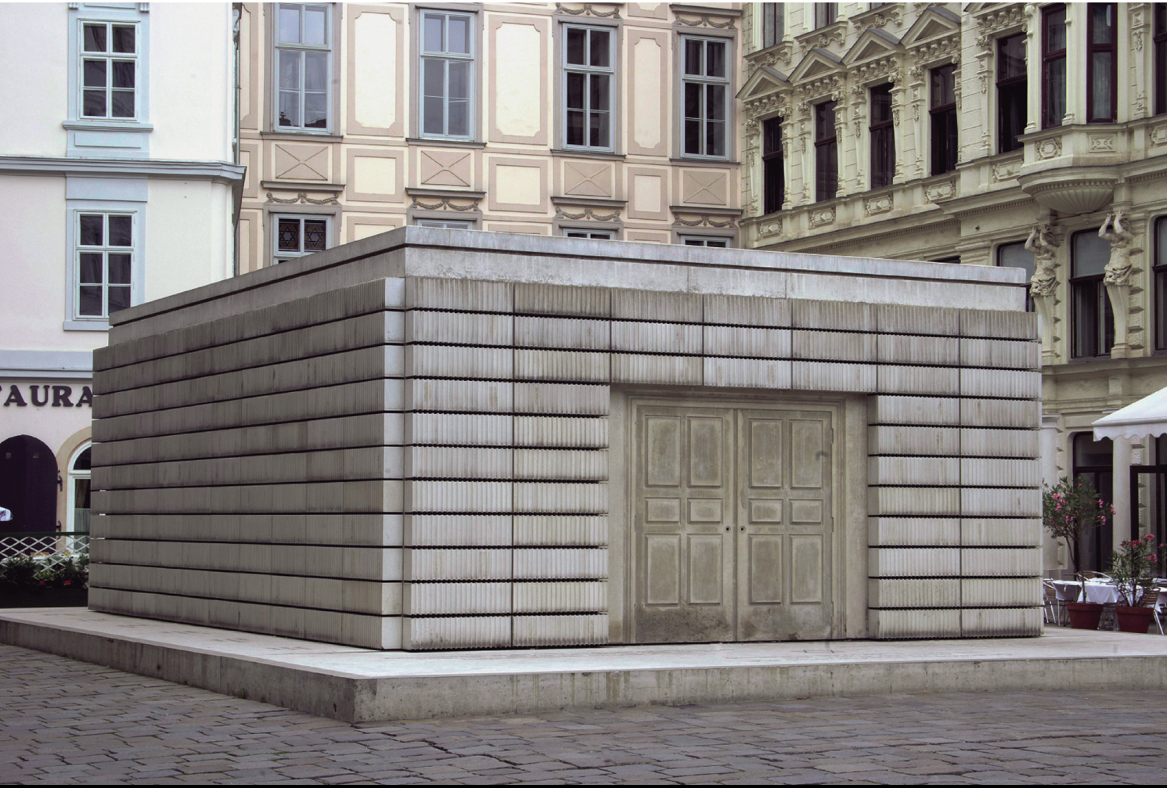
Rachel Whiteread, Holocaust Memorial, 1995–2000. Judenplatz, Vienna. Concrete, 153 1∕2 x 296 1∕8 x 416 1∕2"
Notes:
6.9 Rachel Whiteread, Holocaust Memorial, 1995–2000. Judenplatz, Vienna. Concrete, 153 1∕2 x 296 1∕8 x 416 1∕2" (390 x 752 x 1058 cm). Courtesy of the artist, Luhring Augustine, New York, and Gagosian Gallery.

Slide 26
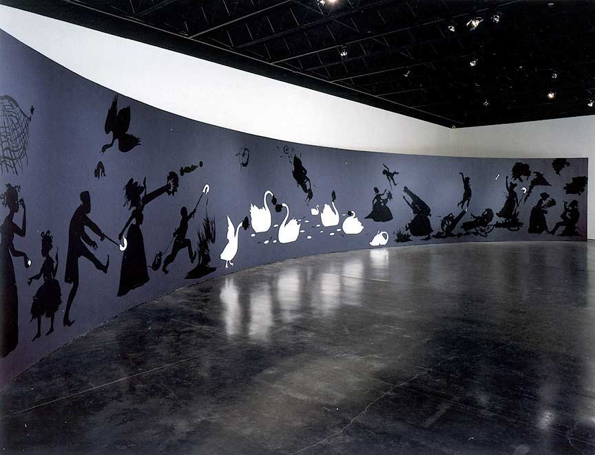
Kara Walker (US b. 1969), No Mere Words Can Adequately Reflect The Remorse this Negress Feels at Having Been Cast into such a lowly state by her former Masters and so it is with a Humble Heart that She Brings about Their Physical Ruin and Earthly Demise, 1999. Installation view at the California College of Arts and Crafts, Oakland, California. Cut paper and adhesive on painted wall, 10 x 65 feet. SFMoMA collection

Slide 27
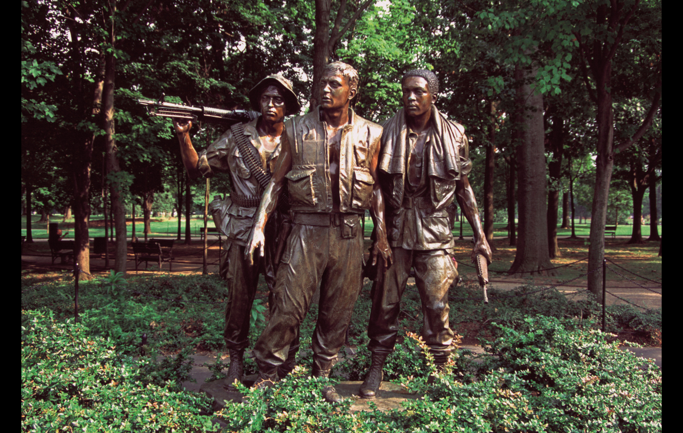
Frederick Hart, The Three Soldiers, 1982–84. Bronze sculpture with black Indian granite base, (sculpture only) 96 x 60 x 36" Washington, D.C.

Slide 28
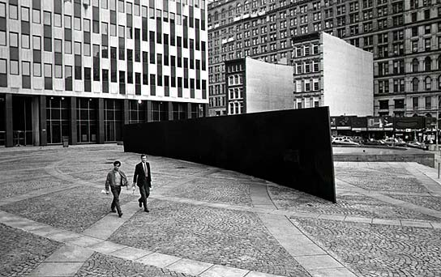
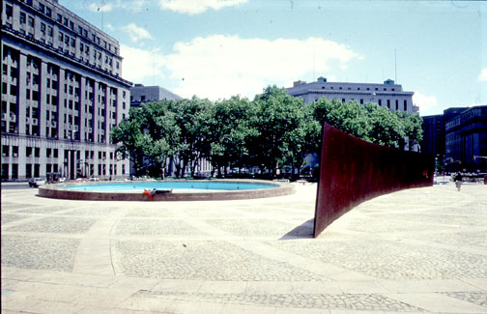
Richard Serra, Tilted Arc, 12ft x 120 ft x 2.5 in, cor-ten steel, Federal Plaza, NYC, 1981-1989, Site-specific commissioned public artwork

Slide 29
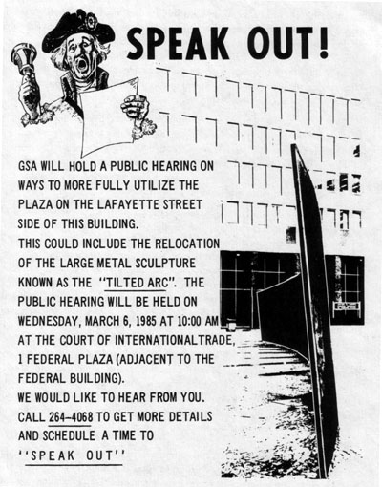
GSA = New York City General Services Administration

Slide 30
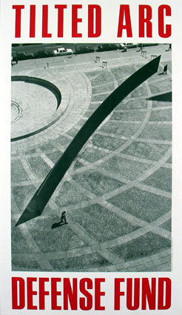
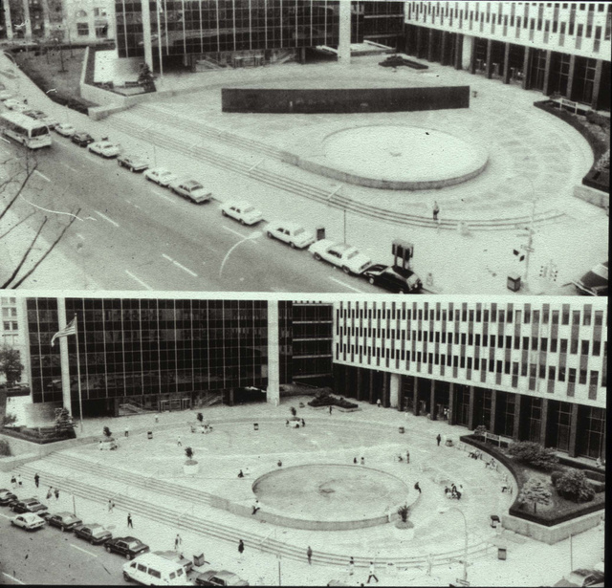
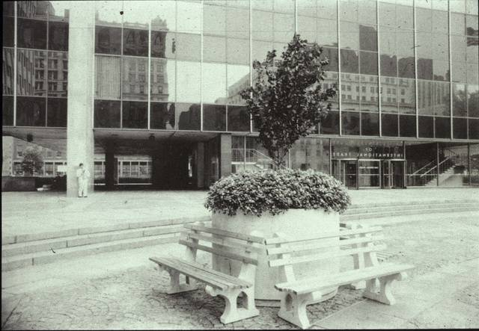
Document from legal
battle to retain sculpture
Federal Plaza before (above) and after (below) removal of Tilted Arc with planters and benches

